Slide 1
Treating Anxiety in Individuals with Intellectual and Developmental Disorders
Laura Politte, M.D.
Child and Adolescent Psychiatrist
Laura Hiruma, PhD
Psychologist
Carolina Institute for Developmental Disabilities
October 2018

Slide 2
Learning Objectives
Discuss anxiety presentation among individuals with intellectual and developmental disorders (IDDs)
Learn about potential signs of anxiety
Identify common triggers and warning signs of anxiety in individuals with IDD
Review evidence-base of treatment options for clinically significant anxiety symptoms
Behavioral treatment options/therapies
Pharmacological treatment options
Learn practical strategies for supporting those with anxiety and IDD
Discuss preventative and proactive strategies

Slide 3
Anxiety: What is it, and why does it happen?
•Anxiety: “A feeling of worry, nervousness, or unease, typically about an imminent event or something with an uncertain outcome.”
•We are hard-wired for anxiety, which is evolutionarily protective.
“Fight or Flight” response

Slide 4
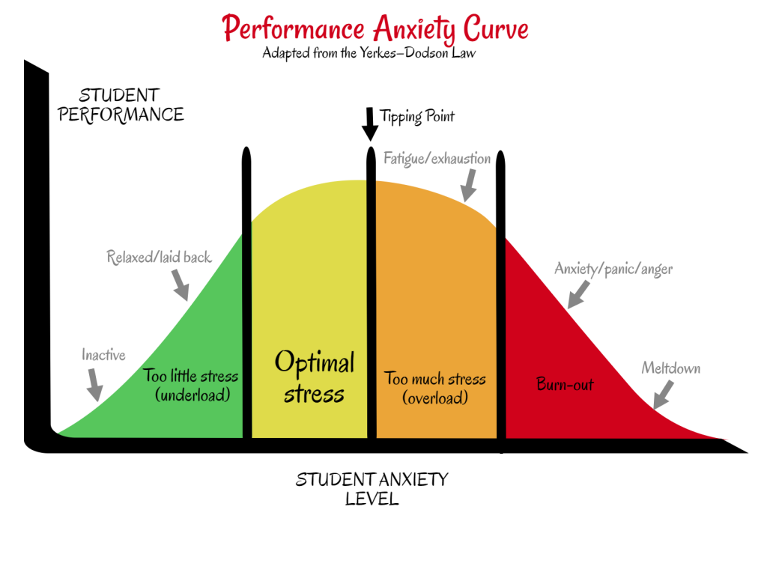
Anxiety exists on a spectrum:
Useful Debilitating
Motivating for stressful tasks
Enhancing performance and attention
Dealing with serious threats
Generalized to low-threat situations
Paralyzing fear/ panic
Inability to make decisions
*Goal is not to remove all anxiety, but learn how to realistically appraise situations and manage anxiety effectively.
Image credit: Abby Weinstein, https://mindprintlearning.com

Slide 5
When does anxiety become a problem?
Causes significant distress
Excessive worry, sadness, physical symptoms, exhaustion, low self-esteem
Causes functional impairment
Academic problems, school refusal, avoidance of people and places, missed work
Leads to behavioral disturbance
Irritability, lashing out, self-harm, running away, "meltdowns"

Slide 6
Anxiety is common in I/DD
40% in ASD, up to 22% in intellectual disability (ID)
Defining feature of some genetic syndromes (Fragile X, Williams, Angelman)
May fit DSM-5 definitions or present as “atypical” variant
Four most frequent DSM-5 disorders include:
Specific phobias (e.g., fear of the dark, insects, needles)
Generalized anxiety disorder
Social anxiety disorder
Obsessive Compulsive Disorder
Symptoms don’t always map neatly onto DSM-5 defined categories
Positive association between anxiety and IQ

Slide 7
Anxiety in ASD: Symptom Overlap
ASD
Anxiety
Extreme upset with change/deviation from routine
Insistence on sameness
Discomfort in social situations
Aversiveness to sensory stimuli

Slide 8
Social Anxiety in ASD
More common in older kids with average or above-average IQ (greater social awareness)
Fear of negative evaluation by peers may be a realistic concern
Distinct from avoidance of social interactions due to lack of interest
Risk factors for social anxiety
Social Anxiety
Elevated physiological arousal
Social skills deficits
Insight into social differences

Slide 9
ASD and OCD
Where do we draw the line?
Fixated, restricted interests Obsessions
Repetitive behavior Compulsions
Distress with rituals/ compulsions may help distinguish, but not always
Hoarding, compulsive ordering, and repetition may be more common in ASD

Slide 10
Factors Contributing to Anxiety
Anxiety
Genes
Modeling and reactions of others
Stressors
Avoidance
Anxious beliefs/thought patterns

Slide 11
Additional Factors Contributing to Anxiety in IDDs
Anxiety
Sensory defensiveness
Social skills deficits/ peer rejection
Difficulty tolerating unpredictability
Difficulty with change/ transitions
Rigid thought patterns
Communication impairment

Slide 12
Recognizing Anxiety
Physical signs: stress-related somatic symptoms (headaches, stomachaches, panic symptoms), muscle tensing, changes in breathing/appearance, fearfulness, restlessness
Cognitive signs: perseveration on distressing topics, anticipatory worries, increased difficulty concentrating, repetitive questions/comments
Behavioral signs: increased agitation or irritability, increased aggressive/self-injuriour behaviors, increased rigidity or resistance, increased sleep disturbance

Slide 13
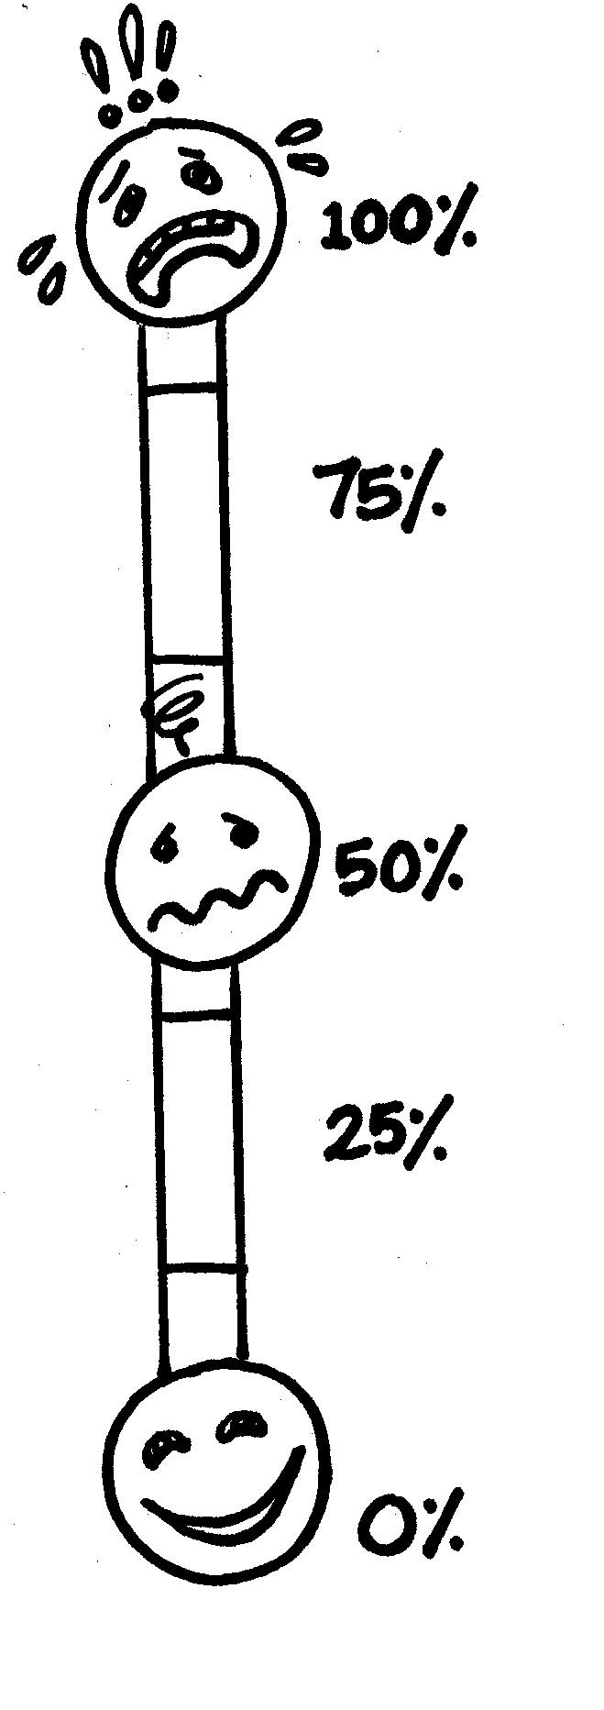
Recognizing Anxiety
Strategies for identifying individual-specific signs:
Past challenging situations/avoidant behavior
How does the individual convey anxiety?
Negative comments/self-statements?
Anticipatory worrying?
Changes in behavior/demeanor?
Changes in physical appearance?
Changes in sleep/adaptive routines?
"Tell" signs prior to increased agitation

Slide 14
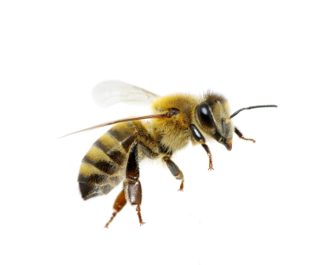
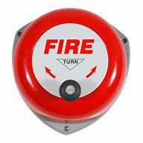
Common Triggers for Anxiety in Individuals with IDDs
The unexpected: new situations, unfamiliar settings, transitions or changes in routine, difficulty separating from familiar caregivers
Sensory experiences: loud/unexpected sounds, crowded or overwhelming environments, enclosed rooms
Social situations: ambiguous cues, unfamiliar people, group situations
Common phobias: bugs/flying insects, shots, storms/weather

Slide 15
When is treatment warranted?
Focus on level of individual distress and functional impairment:
Does anxiety disrupt individual or family functioning?
Does it interfere with developing friendships/relationships?
Does it lead to persistent school avoidance/refusal?
Does it contribute to sleep disturbance?
Does it lead to significant tantrums/meltdowns?
Does it impair academic performance?
Does it lead to compulsive behaviors that are distressing to the individual or interfere with daily functioning?

Slide 16
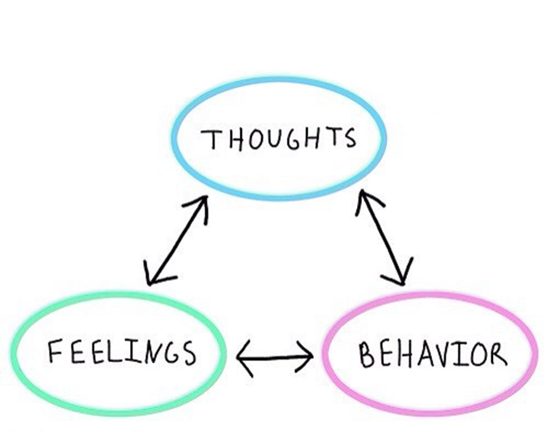
Cognitive Behavioral Therapy (CBT)
Short-term, problem-focused, and evidence-based therapy approach
Collaborative relationship between client and therapist
Involves behavioral modification/skill building and cognitive strategies
Major strategies include cognitive restructuring, building coping skills, and guided problem-solving
May involve elements of exposure and reinforcement-based approaches

Slide 17
Cognitive Styles and Anxiety
Individuals with IDDs may be more likely to exhibit cognitive tendencies linked to anxiety:
•Alexithymia (difficulty reading facial/emotional expressions)
•Need for consistency and certainty
•One-track mind/perseverative thinking
•Rigid/inflexible thinking
•Difficulty converting thoughts and emotions to speech

Slide 18
Modifications for CBT in IDDs
Best suited for individuals with near-average or above cognitive and verbal skills
Use of reinforcement to boost motivation to engage in therapy
Involvement of parent/caregivers in treatment
Possibly increasing the frequency of therapy sessions
Using developmentally appropriate terms and teaching strategies
Multi-modal teaching strategies and visual supports
Additional skill building (communication and social skills training)
Chunking of information with interactive tasks
Providing more concrete emotion education
Use of special interests/strengths

Slide 19
Sample CBT Session
•Psychoeducation
•Cognitive-behavioral skill practice:
- Emotion recognition
- Thought monitoring
- Cognitive restructuring
- Skill practice
- Exposure activities (e.g., gradual, flooding, response prevention)
•Parent/caregiver training and homework

Slide 20
Graded Exposure Hierarchy Example: Fear of Insects
Find and hold a caterpillar outside
Visit a butterfly house
Look at insects in glass containers
Watch You Tube videos of spiders
Stand next to Dad while he holds a caterpillar
Imagine self holding a bug
Pair exposures with relaxation strategies as needed
Establish rewards for accomplishing each step

Slide 21
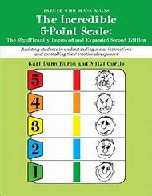
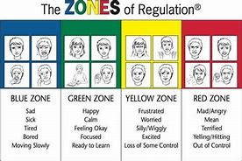
Psychoeducation Tools
The Incredible 5-Point Scale
Zones of Regulation

Slide 23
The Incredible 5 Point Scale
•A cognitive behavior technique to help students learn about personal behavior, emotions and self-control
•Teaches Self-Awareness – sensory, emotions, behavior, coping techniques. Can help adults more deeply understand the needs of the child so they can assist with teaching self-control, self-calming strategies.

Slide 24
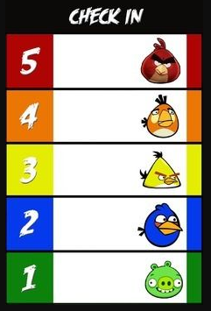
5-Point Scale Examples

Slide 26
ASD-Specific Treatment Protocols
Multimodal Anxiety and Social Skills Intervention
Facing Your Fears
Behavioral Interventions for Anxiety in Children with Autism (BIACA)

Slide 27
Facing Your Fears: Example of Group Therapy
Fifteen, 90-minute group sessions
Child skill-building as well as parent coaching component
Designed for children with high-functioning autism and social phobia, generalized anxiety disorder, separation anxiety disorder, or specific phobia
Focuses on emotion education and cognitive-behavioral strategies using didactic group discussion, visual supports, parent-child activities, video modeling, and positive reinforcement
*Offered locally at TEACCH Chapel Hill Center (ages 8-14)

Slide 28
Facing Your Fears: Essential Elements
Identify child’s worries and associated behaviors, symptoms
Understand connection between body’s reaction and anxious thoughts
Externalize anxiety symptoms (“worry bugs”, “helper bugs”)
Recognition of automatic negative thoughts
Learn relaxation strategies and activities, positive coping statements
Create a hierarchy of anxiety-provoking situations
Develop graded exposure activities based on individual hierarchy
Social skills building
Create and star in a Facing Your Fears video

Slide 29
Practical Approaches for Supporting Anxiety
Preventative:
Anticipate challenging situations
Increase supports, coaching/priming for these situations (use of structured routines, visuals, social stories)
Establish proactive regulating routines (sensory or calming routines)
Address sensory needs (noise-cancelling earphones, weighted vest, movement break)
Provide proactive emotion education and skill building ahead of time
Offer more prosocial ways to communicate distress (visuals, communication supports)
Prime ahead of situations (with reminder of expected behaviors/skills and reminder of reinforcement/contingencies)
Model coping strategies incidentally
Establish a safety plan when warranted

Slide 30
Practical Approaches for Supporting Anxiety
Responsive:
Validate anxious feelings without reinforcing avoidance
Model coping skills and desired behaviors
Redirect and intervene at the first sign of agitation (do not wait for the “point of no return”)
Have available calming aids available in the environment (calming space, sensory toolbox, calming items)
Actively praise and reinforce appropriate communication/coping skills
Minimize verbal discussion/focus on stressor (aside from modeling brief flexible/positive thinking)
Use visuals/concrete language to remind individuals of contingencies/what will be happening
Implement safety measures as needed

Slide 31
Why are medication trials for anxiety in ASD/ID so scant?
Difficulty in defining anxiety in ASD/ID
Symptom overlap
Limits of self-report
Lack of well-established outcome measures
Heterogeneity within ASD/ID
Costly and difficult to undertake

Slide 32
SSRIs approved for anxiety in children without ID/D
Medication | FDA Indication | Approved Ages
Duloxetine* | Generalized Anxiety Disorder | 7+
Fluoxetine | OCD; Depression | 8+ (OCD), 7+ (depression)
Sertraline | OCD | 6+
Fluvoxamine | OCD | 8+
Escitalopram | Depression | 12+
Clomipramine | OCD | 10+

Slide 33
SSRIs in Children with ASD
Despite being commonly prescribed (about 32%), evidence supporting SSRI use in ASD/IDD is limited.
1 large, negative study of citalopram for repetitive behavior
Increased risk of behavioral side effects (“activation”) and insomnia
1 large, negative study and 1 smaller, positive study of fluoxetine for repetitive behavior
1 positive study of fluoxetine for repetitive behavior in adults
1 negative open-label study of fluvoxamine in children
Poorly tolerated in children, but some benefit in adults
*SSRIs may be more effective and better tolerated in adults than children with ASD.
*No studies yet with anxiety as the primary outcome of interest.

Slide 34
Approach to medication for anxiety in I/DD
Best if used in combination with therapy and behavioral strategies
Start low, go slow
Consider meds well-studied in children first (usually fluoxetine and sertraline)
Look out for behavioral side effects with SSRIs
Define how improvement will be gauged (and what medication can't do)
Some trial and error involved
Consider less traditional choices (buspirone, mirtazapine)

Slide 35
Use of Medication for Anxiety
(Off-label) prescribing guidelines:
Start with SSRI (fluoxetine or sertraline) at very low dose (liquid preparations can help). Follow similar monitoring guidelines as used in anxiety in children without ASD.
Consider buspirone or mirtazapine as alternatives.
Less likely to cause behavioral activation.
Buspirone now studied in young children (2-6)
Mirtazapine may also be helpful for sleep, poor appetite
Use benzodiazepines only with caution.
Paradoxical agitation is common.

Slide 36
Challenges to Treatment/ Future Directions
Clinicians with expertise in both ASD and anxiety are hard to find
Fewer still trained in CBT
Even fewer in private practice accept insurance
Limited resources in rural areas
Long waiting lists in well-resourced areas
Lack of evidence base for medication use

Slide 37
Summary: Treatment of Anxiety in ASD/ ID
Target the source of anxiety with appropriate behavioral interventions.
Modify the environment as needed.
CBT, social skills, behavioral therapy considered first-line.
Limited evidence base for psychotropic medication.
Consider cautious SSRI, buspirone, or mirtazapine trial.
Consider age, side effect profile, and previous treatments when selecting agent.
Start low, go slow.

Slide 38
Additional Resources
TEACCH Chapel Hill, Facing Your Fears group: http://teacch.com/regional-centers/chapel-hill-teacch-center/face-your-fears-intervention-group
Autism Treatment Network Blood Draw Toolkit: https://www.autismspeaks.org/science/resources-programs/autism-treatment-network/tools-you-can-use/blood-draw-toolkits
The Incredible 5-Point Scale: http://www.5pointscale.com/smart_ideas.htm
Autism Treatment Network Medication Decision Aid: https://www.autismspeaks.org/science/resources-programs/autism-treatment-network/tools-you-can-use/medication-guide
Association for Behavioral and Cognitive Therapies (finding a CBT therapist): http://www.findcbt.org/xFAT/

Slide 39
Carolina Institute for Developmental Disabilities
101 Renee Lynne Court
Carrboro, NC 27510
T 919-966-5171
F 919-966-2230
Mailing Address:
University of North Carolina at Chapel Hill
Campus Box #7255
Chapel Hill, NC 27599-7255
www.cidd.unc.edu
Notes:
39

